Slide 1
Change and innovation for sustainable tourism
Lecture 10

Slide 2
Sustainable tourism is about the future
To understand the future, you can either project from past trends, or use scenarios (but doesn’t account for disruptors).
- Past trends – a spectacular growth, geographic expansion and increasing economic dependency some regions
Scenarios – what is likely to happen based on trends in STEEP areas, and expert opinion
Disruptors, black swans,

Slide 3
Why is planning for change important?
Tourism relies on discretionary income and time
Involves a complex supply and distribution chain
Has many stakeholders at different levels
Is vulnerable to trends and events outside of its control

Slide 4
Understanding change
There are TWO main types of change:
1. Structural change
2. Temporary change, e.g. demand and supply cycles or crises/disasters (SARS, Boxing Day Tsunami)
Structural change can be gradual and sometimes hard to recognise…
“If you fail to plan, you plan to fail”

Slide 5

Structural change
Five areas where we might see structural change:
1. Social
2. Technological
3. Environmental
4. Economic
5. Political (and legal)
-> Innovation allows you to get ahead of change.

Slide 6
Tourism trends that affect growth
A STEEP approach
Social trends – e.g. growing middle class in emerging economies
Technological – e.g. ICT advances
Economic – e.g. growth of BRICS nations’ economies
Ecological – e.g. GHG emissions
Political – e.g. changes in border regulations

Slide 7
Ways of understanding change
Forecasting and Business as Usual approaches
Scenario-based planning: offers the chance to explore more complexity and uncertainty, presenting alternative, plausible futures.
Ask the expert – e.g. through a Delphi study, rounds of expert consultation, consolidation and confirmation of expert ideas.

Slide 8
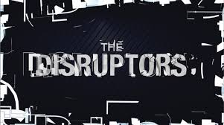

Slide 9
Possible disruptors
a serious pandemic, where travel becomes personally risky and is highly regulated to prevent further spread of the biohazard,
a regional conflict in the Middle East that disrupts oil supplies,
another prolonged volcanic eruption that interrupts aviation routes,
abrupt climate change that leads to stricter GHG emissions regulations.

Slide 10
Artificial intelligence
Exponential rate of change
Unknown future outcomes

Slide 11
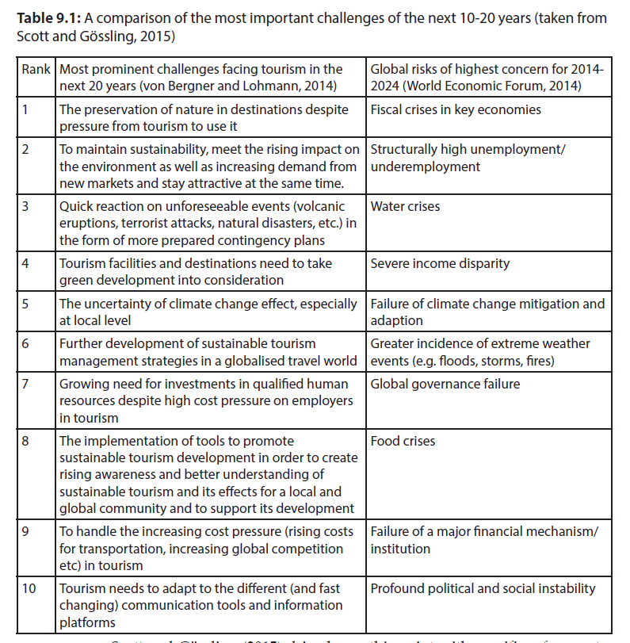
Scott and Gössling (2015) compare global risks vs tourism risks for next decade

Slide 12

Innovation
A way to meet the challenges of the future or just a buzzword?
Innovation is poorly developed in tourism

Slide 13
What is innovation?
Defined as the implementation of organisational learning, new ideas, new processes and products within an organisation
Is an indication of firm performance Ensures that the business keeps up with, or is ahead of, societal trends
More commonly applied to products than services
Can be in the form of ‘imitative’, ‘incremental’ and ‘discontinuous’ to ‘really new’ and ‘radically innovative’
Ensures that the business keeps up with, or is ahead of, societal trends

Slide 14
Four types of innovation
Product or service: new & observable to customer
Process: back of house efficiency operating systems
Marketing: communication with customers
Managerial: aimed at staff satisfaction
Notes:
e.g. of marketing = loyalty programs

Slide 15
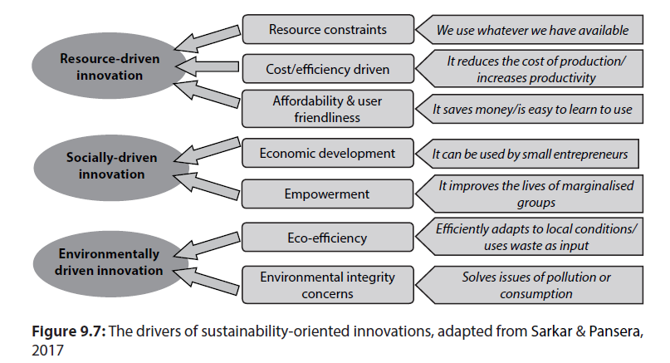
Sustainability-oriented innovations

Slide 16
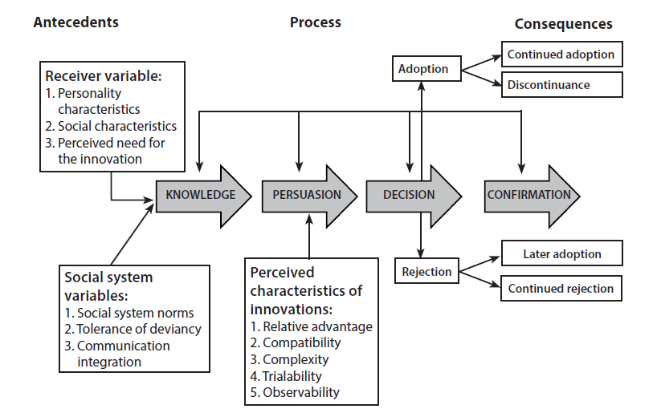
The adoption of innovation
Rogers’ diffusion of innovations model
Five attributes required for successful market diffusion for innovation:
1. relative advantage,
2. status (social kudos),
3. compatibility,
4. complexity (too complex is a negative) and
5. trialability.

Slide 17
Vs the non-adoption of innovation
Innovation characteristics
Value barrier
Usage barrier
Image barrier
Risk barrier
Consumer inertia (personality)
Resistance to change (personality)
Behavioural constraints
Switching costs
Sunk costs
Habit
Awareness

Slide 18
Smart tourism
Combines sensors, big data, open data, new ways of connectivity and exchange of information (e.g., Internet of Things, RFID, and NFC) as well as abilities to infer and reason.
Fuzzy concept that is poorly defined but BUZZWORD
and often applied to sustainability, e.g.
(i) Barcelona’s interactive bus shelters provide touristic information and bus arrival times but also USB ports for charging mobile devices.
(ii) Brisbane has over 100 beacons at PoIs to communicate information to tourists via a mobile app if they are within a certain radius of the location
(iii) Amsterdam uses beacons to let tourist signs translate themselves into different languages and the Amsterdam ArenA is testing sensors for better crowd management

Slide 19
VR & AR
Augmented Reality – usually used with location devices, collect rewards as part of tour (Pokemon Go), access extra information about an attraction or destination, or represent features that are not physically present anymore
Virtual reality – represents a destination or attraction at prepurchase stage, allow you to “sample” destination; recreates artefacts that either no longer exist or can’t be shown; creates narratives of a place; Opens up opportunities for travellers with mobility issues or destinations that are not accessible

Slide 20
The digital economy
Also “peer-to-peer” or “collaborative economy”
Brings together online, mobile, and social.
Appeals to search for authenticity and local encounters.
Used for accommodation, transport, meals.
Legitimacy? Quality? Safety?

Slide 21
Up next
The future of tourism as viewed through other models (deep leverage points of paradigm changes)

